Slide 1

Instagram
User
Analytics
Saloni Mate
salonimate20@gmail.com

Slide 2
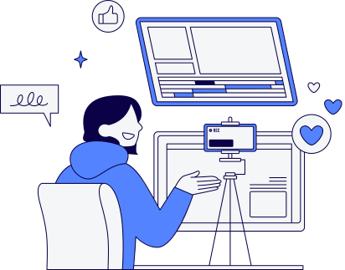
Content
Introduction
Marketing Department Analysis
Investor Metrics Analysis
Summary

Slide 3
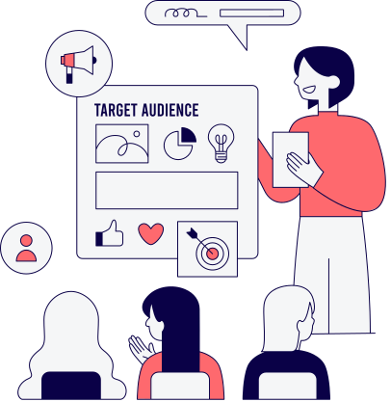
Introduction
This project focuses on analyzing user interactions and engagement with the Instagram app to generate actionable insights for business growth.
Detailed reports are provided for the marketing department and investors.
This analysis will help them to make a decision based on different metrics and insights

Slide 4

Marketing Department Analysis
Rewarding Most Loyal Users
5 oldest users of the Instagram from the provided database
Notifying Inactive Users to Post
Identified users who have never posted a single photo on Instagram
Declaring Contest Winner
Identified the winner of the contest and provided the details to the team
Hashtag Research
Identified and suggested the top 5 most commonly used hashtag on platform
Launch Ad Campaign
What day of the week most users registered. Provided insights on when to schedule an ad campaign

Slide 5

User Engagement
Provided insights on, how many times average user posts on Instagram. Also provided insight on photos per user on the platform to understand the user engagement
Bot and Fake Accounts
Investor Metrics Analysis
Identified and provided the data of users who are potentially a bot, who has liked every single photo on Instagram

Slide 6
Rewarding Most Loyal Users
Top 5 oldest users
1
2
3
4
5
Darby_Herzog
2016-05-06
Emilio_Bernier52
2016-05-06
Elenor88
2016-05-08
Nicole71
2016-05-09
Jordyn.Jacobson2
2016-05-14

Slide 7

Notifying Inactive Users
To Start Posting
There are 26 users which are inactive, who never posted a single photo on Instagram. They will be receiving promotional emails to post their first photo
5 - Aniya_Hackett
7 - Kasandra_Homenick
14 - Jaclyn81
21 - Rocio33
24 - Maxwell.Halvorson
25 - Tierra.Trantow
34 - Pearl7
36 - Ollie_Ledner37
41 - Mckenna17
45 - David.Osinski47
49 - Morgan.Kassulke
53 - Linnea59
54 - Duane60
57 - Julien_Schmidt
66 - Mike.Auer39
68 - Franco_Keebler64
71 - Nia_Haag
74 - Hulda.Macejkovic
75 - Leslie67
76 - Janelle.Nikolaus81
80 - Darby_Herzog
81 - Esther.Zulauf61
83 - Bartholome.Bernhard
89 - Jessyca_West
90 - Esmeralda.Mraz57
91 - Bethany20

Slide 8


Declaring Contest
Winner
In the contest, the user with the most likes on a single picture won.
Details
User ID
52
Username
Zack_Kemmer93
Photo ID
145
Photo Likes
48

Slide 9

Hashtag Research
Top 5 hashtags that are most frequently used on Instagram
#Smile
#Beach
59
#Party
42
#Fun
#Concert
39
38
24

Slide 10
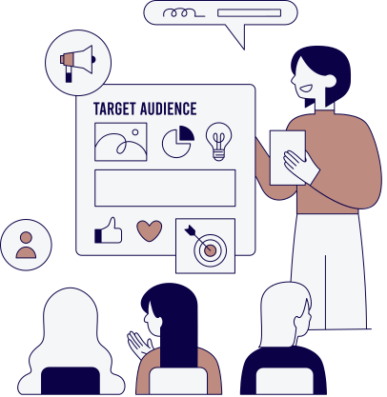
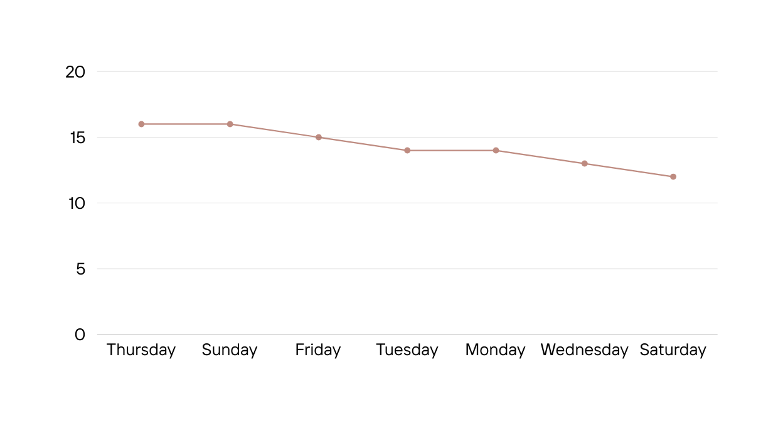
Launch AD Campaign
Registrants are mostly active on this day of the week
Thursday
16
Sunday
16
The best time to schedule an advertisement campaign is on Thursday and Sunday.
16
16
15
14
14
13
12

Slide 11
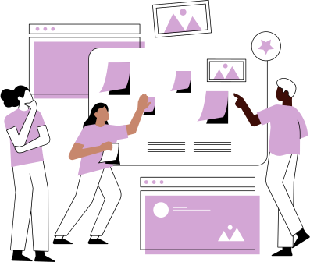


User Engagement
Based on the results
74 active users who have posted at least once
100 total users as per the data
257 total posts made
Average posts per users is 3.
Active users, posts 3 - 4 times on Instagram

Slide 12

Bot & Fake Accounts
The users who have liked every single photo
on Instagram, are possibly a bot or fake account
Below is the list of 13 suspected bots or fake accounts who have liked every single photo on Instagram
5 - Aniya_Hackett
14 - Jaclyn81
21 - Rocio33
24 - Maxwell.Halvorson
36 - Ollie_Ledner37
41 - Mckenna17
54 - Duane60
57 - Julien_Schmidt
66 - Mike.Auer39
71 - Nia_Haag
75 - Leslie67
76 - Janelle.Nikolaus81
91 - Bethany20

Slide 13

Approach
Tech-Stack Used:
MySQL Workbench
Version 8.0.31 build 2235049 CE (64 bits)
MySQL is used to extract data from the given database
Joins, Aggregation, group by, subqueries and other functions
are used to analyze the data
Data is analyzed by the requirements specified by marketing and
sales team for investor metrics
Canva
For making presentation more engaging
Database File
https://drive.google.com/file/d/1zn__CoybhGfAswwpyB8kIcd1OyNi-4cW/view?usp=drive_link
Analysis Queries
https://drive.google.com/file/d/1oInPzF7VgQXYChZVsNdvXhDLxNT610pN/view?usp=drive_link

